Slide 1
CSS3 Transitions and Animations
And how to trigger them with JavaScript
Presented by: Logan Pierce

Slide 2
Transitions within CSS
It’s possible to make transitions within CSS code. Common methods include:
:hover (when a mouseover occurs)
:active (by means of a mouse click.)
:focus (similar to active.)
:checked (limited effects for check boxes.)
:disabled (when element is added or removed.)
Transitions within CSS work best when limited to simple animations.

Slide 3
CSS Transitions using Javascript
Transitions in CSS are applied to an element and specify that when a property changes it should do so gradually.
These transition properties allow elements to change values over a specified duration, animating the property changes, rather than having them occur immediately.
Animations offer you more control and allow you to pause the animation multiple times.
Javascript triggers CSS transitions or animation.

Slide 4
Why Use Javascript?
Use JavaScript animations when you want to have advanced effects like bouncing, stop, pause, rewind, or slow down.
Creating animations with JavaScript is, by comparison, more complex than writing CSS transitions or animations, but it typically provides developers significantly more options.
CSS transitions and animations are ideal for bringing a navigation menu in from the side, or showing a tooltip. You may end up using JavaScript to control the states, but the animations themselves will be in your CSS.
To trigger an element's transition using Javascript, toggle a class name on that element that triggers it.

Slide 5
Pausing Animation
To pause an element's transition, use “getComputedStyle” and “getPropertyValue” at the point in the transition you want to pause it. Then set those CSS properties of that element equal to those values you just got.
(Discuss match game animation.)
https://www.the-art-of-web.com/javascript/css-animation/

Slide 6
State of Play
The “animation-play-state” property of CSS is useful when you need to pause an animation and potentially continue it later. You can change the CSS through JavaScript:
element.style.webkitAnimationPlayState = "paused"; element.style.webkitAnimationPlayState = "running";
However, when a CSS animation is paused using animation-play-state, the element won’t be able to resume running fluidly from the new transformed state. The animation will seem jerky and choppy each time it resumes.

Slide 7
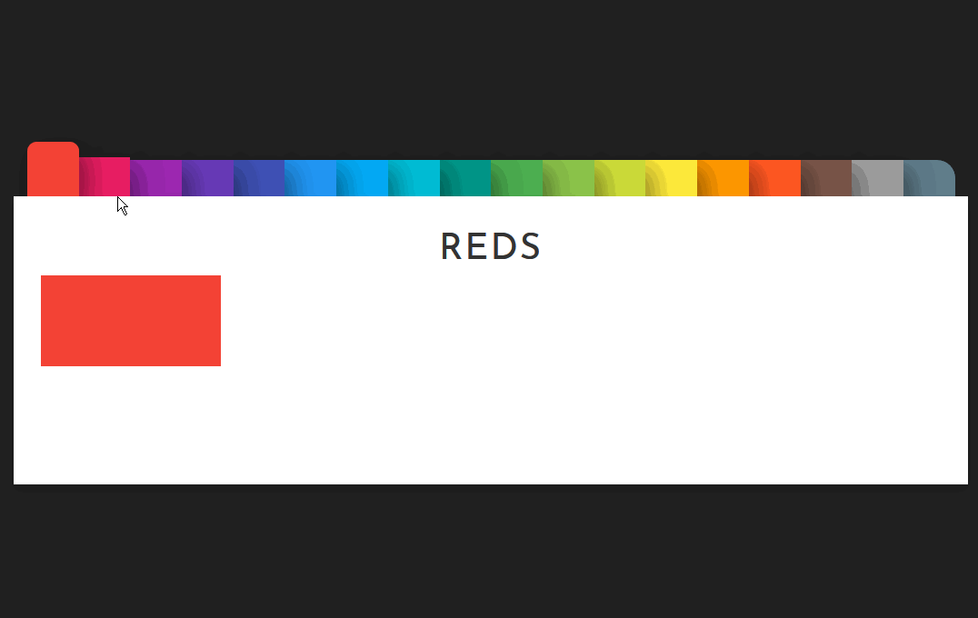
Example: Color Change
This is just one example of the things you can do with CSS transitions using Javascript!

Slide 8
Animation Resource Libraries:
https://www.sitepoint.com/our-top-9-animation-libraries/

